Slide 1

Week 3 – Mathematics for Cryptography II
CT5046 Cryptography and Security
University of Gloucestershire

Slide 2
Overview
Congruence
Greatest common divisor
Chinese Remainder Theorum
Entropy
Recap of lecture
Post-sessional work

Slide 3
Congruence

Slide 4
Overview
Given two integers a and b, we say that a and b are congruent with respect to m if:
They both result in the same remainder (aka. modulo) r when divided by m
Their difference (a − b) is divisible by m
To put this into a mathematical equation, it is written as:
a ≡ b (mod m)

Slide 5
Examples
2 and 12 are congruent with respect to 10 since:
2 ≡ 12 (mod 10)
Similarly, 3 and 6 are congruent with respect to 3 since:
3 ≡ 6 (mod 3)

Slide 6
Properties
For any two integers a and b, the following properties hold true:
a ≡ a (mod m) for all values of a
If a ≡ b (mod m), then b ≡ a (mod m)
If a ≡ b (mod m) and If b ≡ c (mod m), then
a ≡ c (mod m)

Slide 7
Greatest common divisor

Slide 8
Overview and example
GCD is when we have two non-zero integers a and b, the greatest common divisor (gcd (a, b)) is the largest number that can divide both of them.
For example, if a = 50 and b = 10 then gcd(50, 10) then is 5 since:
50 = 5 × 10 = 5 × 5 × 2
10 = 5 × 2

Slide 9
Overview and example
To calculate the gcd of two integers a and b, there are two different techniques:
Prime factorisation
Breaking down each number into its multipliers and taking the
Common multipliers
Easy to understand, difficult to implement
Euclidean algorithm
Based on modulo arithmetic
Can be implemented through programming

Slide 10
Euclidean algorithm
Based on the observation that for any two nonnegative integers a and b:
gcd(a,b) = gcd(b,a mod b)
Used in the factorisation of large-scale numbers
Can be implemented through programming

Slide 11
How it works
= 1 * 52 + 12
52 = 4 * 12 + 4
= 3 * 4 + 0

Slide 12
Algorithm
INPUT: Integers a > b >= 0
OUTPUT: GCD(a, b)
1. if b = 0 then return (a)
2. return (GCD(b,a mod b))

Slide 13
Chinese remainder theorem

Slide 14
Overview
If we have a set of congruences such that:
x ≡ a1 (mod m1)
x ≡ a2 (mod m2)
x ≡ a_{k} (mod m_{k} )
There is exactly one solution x ∈ Zm satisfying all of them.
Zm is a residue set consisting of all possible moduli with respect to a modm operation

Slide 15
Conditions
gcd(m_{i},m_{j}) = 1
2 m = mi × m2 × m3..,×m_{k}
a1, a2,...,a_{k} and m1, m2,...,m_{k} are integers

Slide 16
How it works
Step 1: For each zi in z1, z2, ...,z_{k} , calculate zi = m/mi
Step 2: For each yi in z1, z2, ...,z_{k} , calculate Y_{i} = z_{i}⁻ ¹(mod m_{i})
Step 3: The value of x then becomes x = a1y1z1 + ..+ a_{k}y_{k}z_{k}

Slide 17
Example
Imagine that we want to find the value of x in Z60 such that
x ≡ 3 (mod 4)
x ≡ 2 (mod 3)
x ≡ 4 (mod 5)
Step 0 - Initialise: a1 = 3, a2 = 2, a3 = 4, m1 = 4, m2 = 3, m3 = 5, m = 4 × 3 × 5 = 60

Slide 18
Example
Step 1: Calculate z1 = m/m1 = 60/4 = 15, z2 = 20, and z3 = 12 Step 2: Calculate the module inverse zi yi ≡ 1 mod mi . In other we want to solve the following:
15y1 ≡ 1 mod 4
20y2 ≡ 1 mod 3
12y3 ≡ 1 mod 5
Based on calculations, y1 = 3, y2 = 2, and y3 = 2

Slide 19
Example
Step 3: Finally calculate the value x by:
x ≡ a1y1z1 + a2y2z2 + a3y3z3 ( mod 60)
x ≡ 3 × 3 × 15 + 2 × 2 × 20 + 4 × 3 × 12 ( mod 60)
x ≡ 59 (mod 60)

Slide 20
Entropy

Slide 21

Overview
Refers to the “randomness” in cryptography or the unpredictability
The higher the entropy value is, the greater is the unpredictability of the data
It is calculated using:

Slide 22
A breakdown
X – all possible outcomes
P(x_{i}) – probability of a certain outcome
Logb p(x_{i}) – the outcome of all information
Summation – addition of all possible outcomes and weighs them for overall uncertainty
- - Ensures the value is positive

Slide 23
Questions on entropy
Where should entropy be applied in cryptography and why?
Can you think of anything else that has high entropy and why?

Slide 24
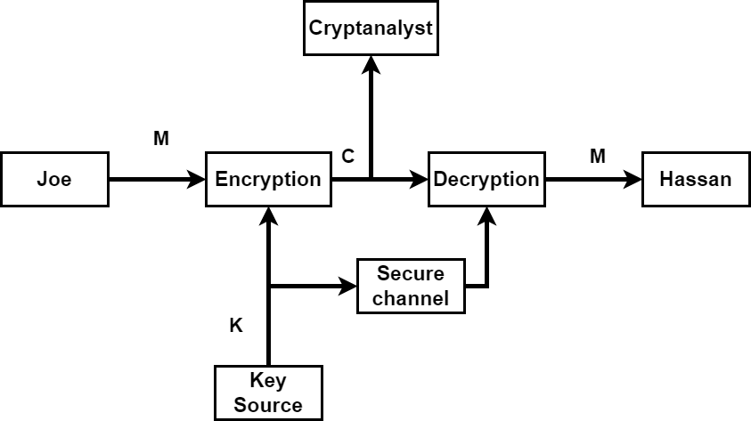
Model of secret communication

Slide 25
Passive attacks
Ciphertext only K
Analysing the ciphertext produced
Known plaintext
Uses both plaintext and ciphertext
Chosen plaintext
Uses plaintext on a given cyphersystem to analyse ciphertext obtained
Chosen ciphertext
Uses ciphertext on a given cyphersystem to analyse plaintext obtained

Slide 26
Operations
According to Shannon, a cryptosystem has perfect secrecy if:
H(M) ≤ H(K)
For this to happen, the size (or more specifically, the length) of K needs to be at least as large as the size of the plaintext.

Slide 27
Recap
Today we looked at congruency and greatest common divisor
We also looked at Euclidean algorithm and the Chinese remainder theorem
We discussed entropy and its role within cryptography
Next week: Symmetric encryption

Slide 28
PSS
Write a report on your findings around symmetric encryption
Look at the different types and identify some possible issues with this form of encryption
Upload to Moodle by next Thursday

Slide 29
Questions?

